Slide 1
Registration insights
Feedback on the design thinking sessions
Notes:
Welcome everybody to the registration’s insights talk. I will be taking through the process of design thinking workshops and how that feedback led to our designs. My name is Robyn Harris. I have been working at AdaptIT for just over 2 years this is my third ITS User Group Conference and I am a User Experience Engineer with the NextGen team.

Slide 2
The Story of Registrations
The Design Thinking Workshops
How we solved the pain
Registrations insights functionality
Notes:
This is what we will be talking about today. First we will go through a story of registrations.
Next I will tell you about the design thinking workshops we had and the results we got from our activities.
Then I will tell you how we solved for the pain points raised in the design thinking workshops.
Finally we will get to the good stuff, and I will show you some of the designs for the new registration’s insights module.

Slide 3
https://www.pexels.com/video/people-walking-in-park-13601231/
Notes:
So registrations cycle is opened and despite Registrations being online students still line up outside the institutions at the beginning of the year. It’s hot it’s frustrating for both students and administrators. Most students are hopeful they will still get a space. Other students still queue up outside the institution because their parents don’t trust the online payment processes. These students are approached by a professional looking man who offers to process their payments so when they get to the front of the queue the process is streamlined.
This man does NOT work for the institution.
This is a problem.

Slide 4
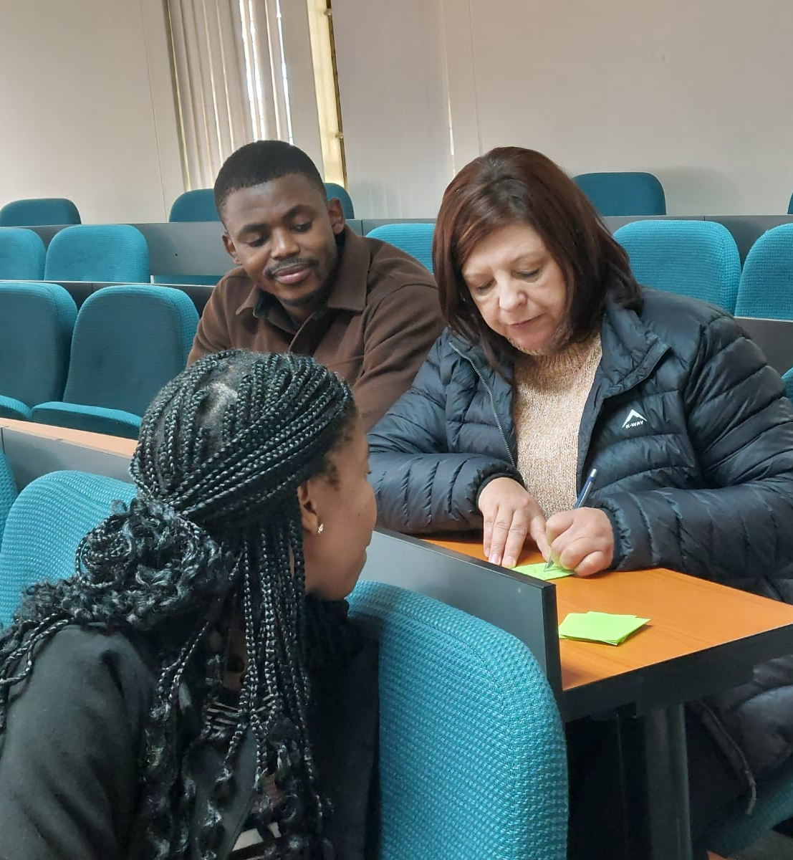
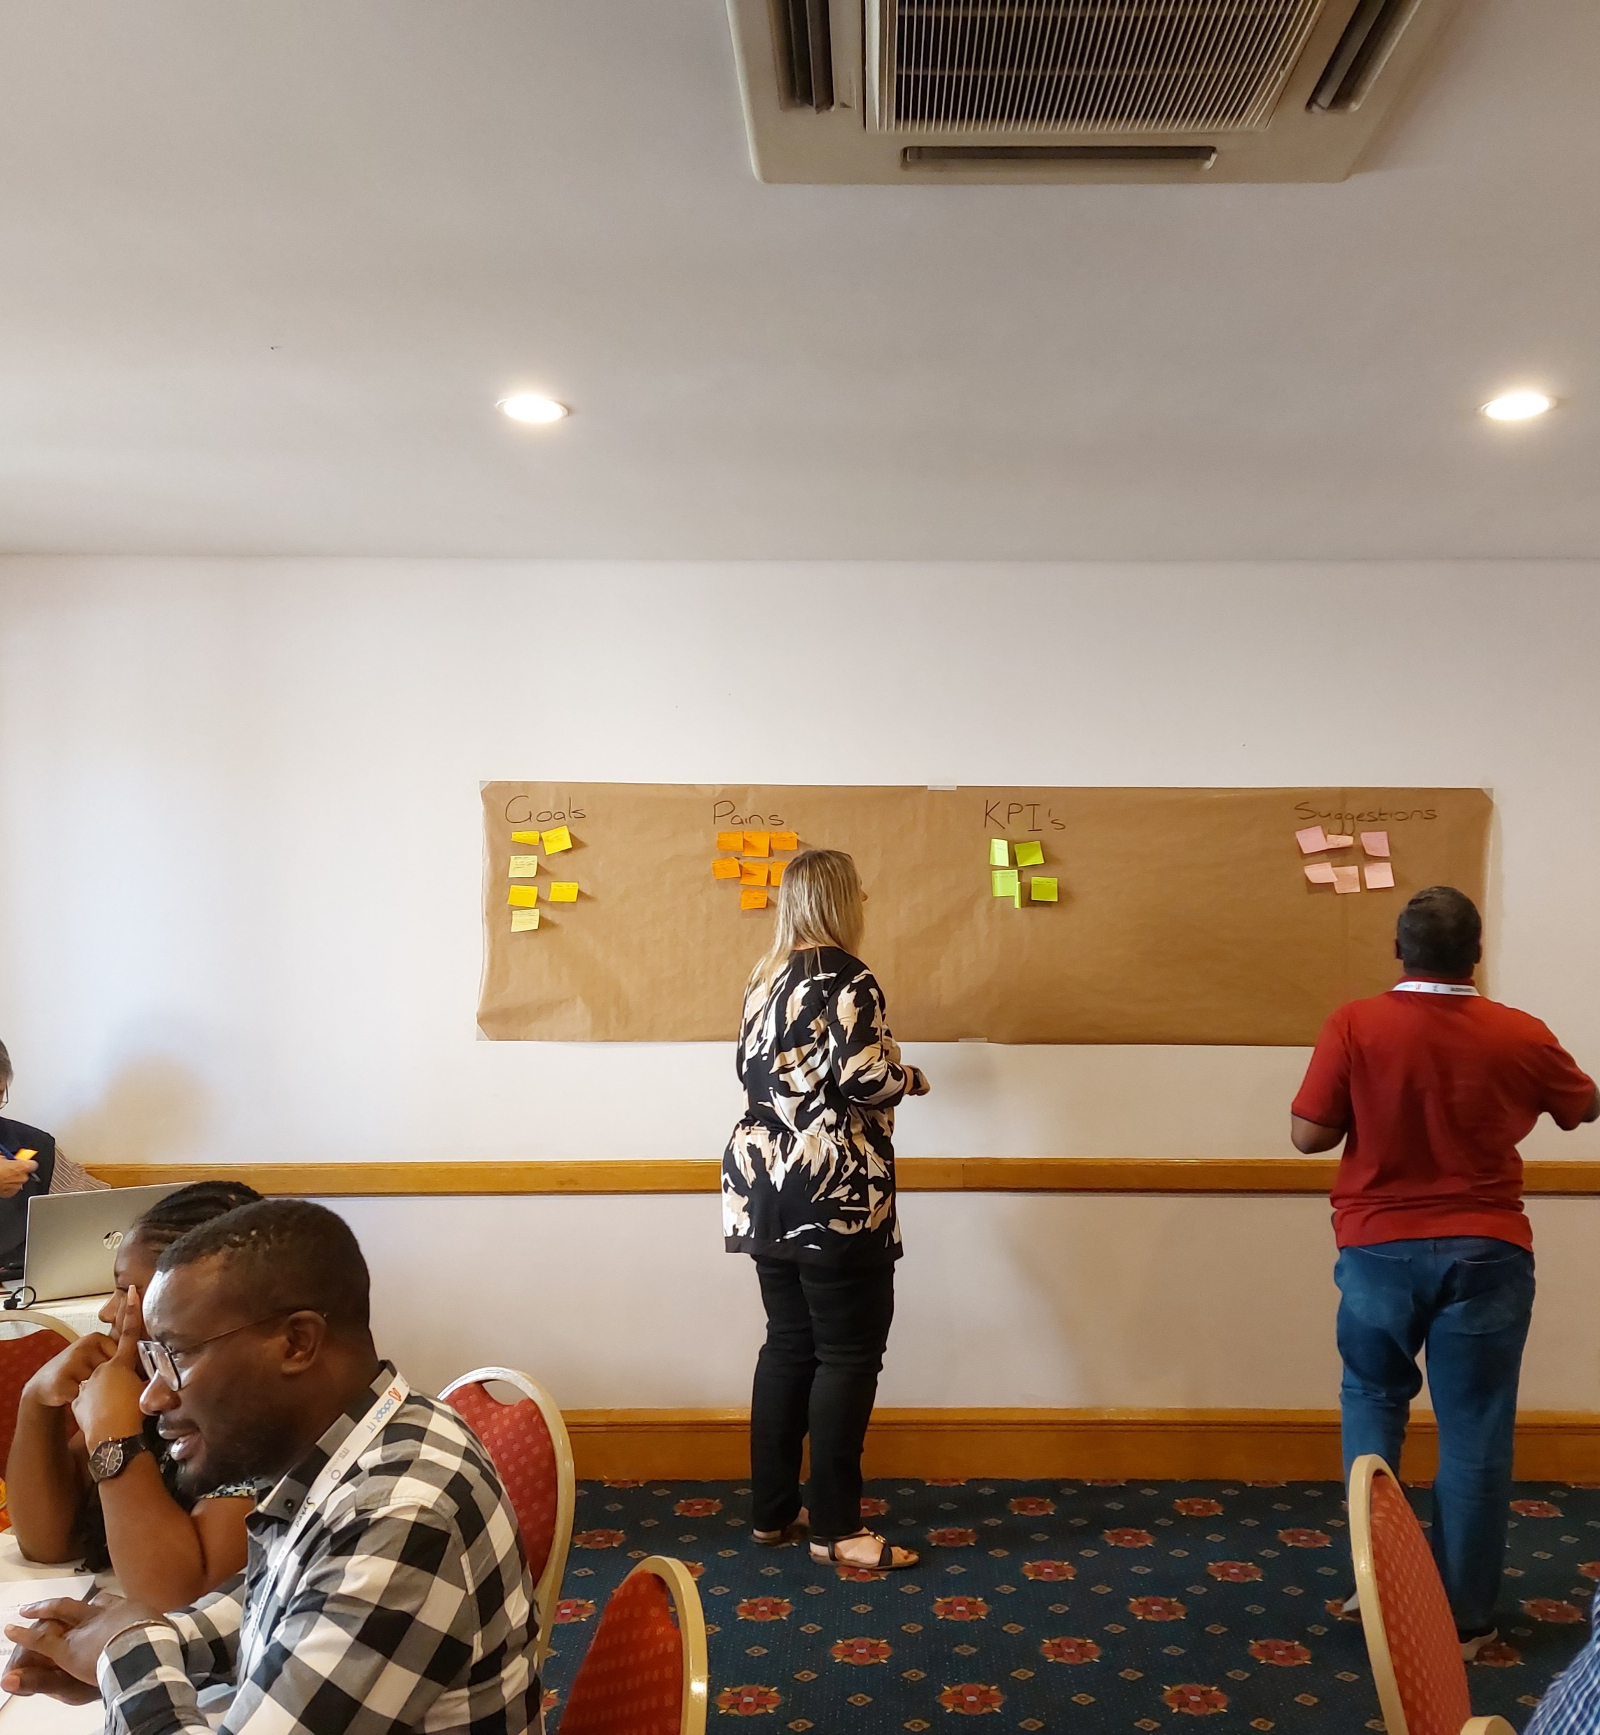
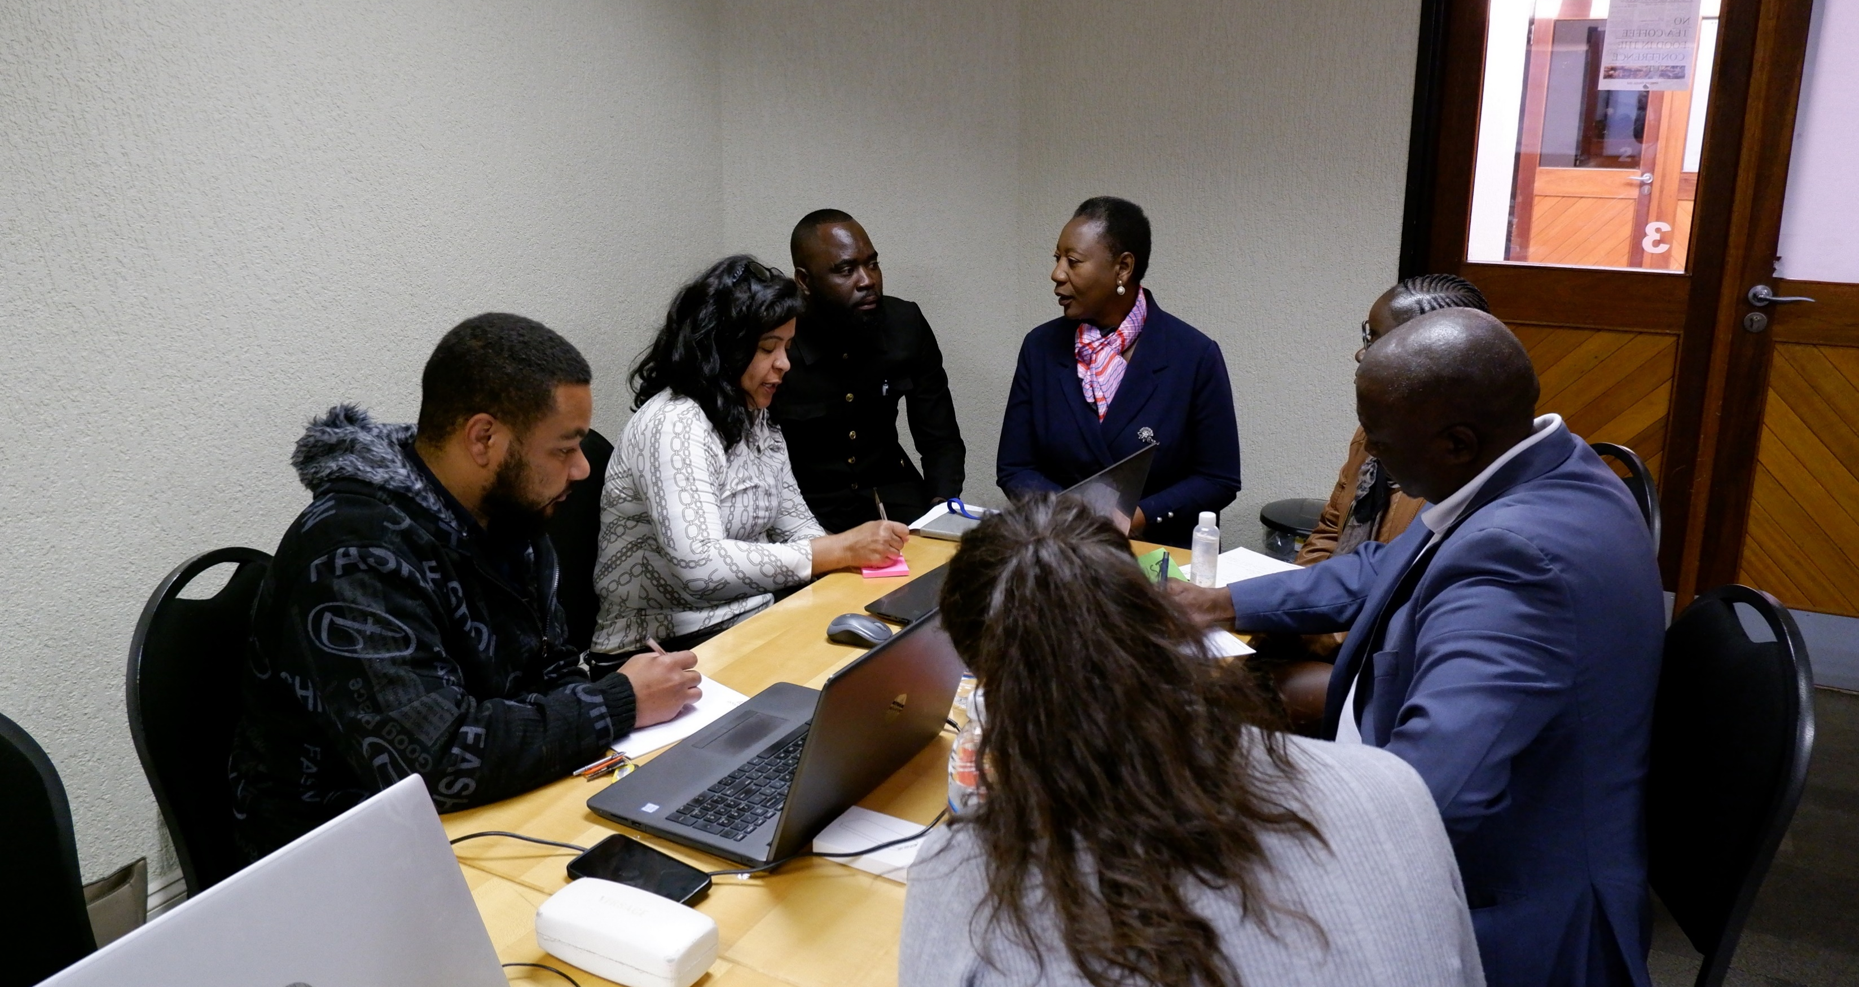
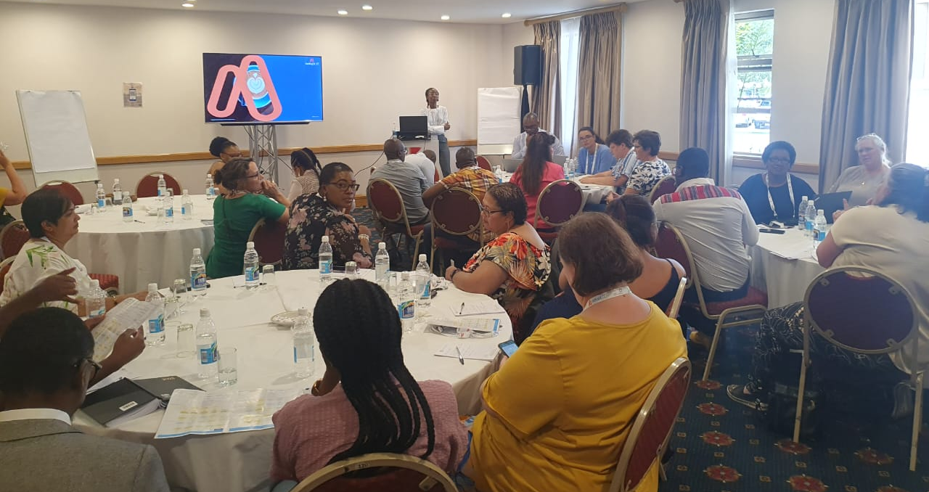
Design Thinking
Notes:
We held client engagements to determine the scope of the registrations problem. The design team travelled around the country to Western Cape, Eastern Cape and Gauteng obviously. We also travelled to Namibia to ensure we garner all relevant information, and our research is internationally robust. We met with a variety of individuals who contributed to our knowledge gathering and solution mining. Here are some of the photographs of the interactions.
Activities and exercises

Slide 5
20 Client Engagements (+- 260 participants)
Persona | #’s
Registrars | 19
Managers | 24
Senior Admin | 7
Supervisors | 2
Administrators/Officers/Coord | 57
Student Finance Admin | 6
CFO’s | 1
VC | 2
Non-Identified (didn’t say) | 139
Total | 259
Notes:
Here we see the institution logos that have been involved thus far. If you do not see your institution up here and you have not been involved in a design thinking session, please contact Claire and she will ensure you are invited to the next round of sessions. It’s very important for us to get as many insights as possible and from as many different viewpoints. Here you can see all the roles and job types we have spoken to.

Slide 6
Pain Point Analysis – Client Perception
Notes:
Pain points are the core of our analysis when looking at an existing product or ideating a new one. It’s essential that we understand what the current experience is when performing a task or flow.

Slide 7
How we solve the pain
Not knowing what is going on
Boost visibility
Stress
Dashboard
Unmet quotas leads to fines
Unmet Quotas
Targets
For each Faculty, department, qualification
Audits
Pre-check
.
Audits are stressful and often are obscure
Pre-check your audit criteria to make changes and solve issues ahead of time.
Unfilled spaces
Reallocation
Get stuck with unfilled spaces in certain qualifications
Reallocate spaces in real time

Slide 8
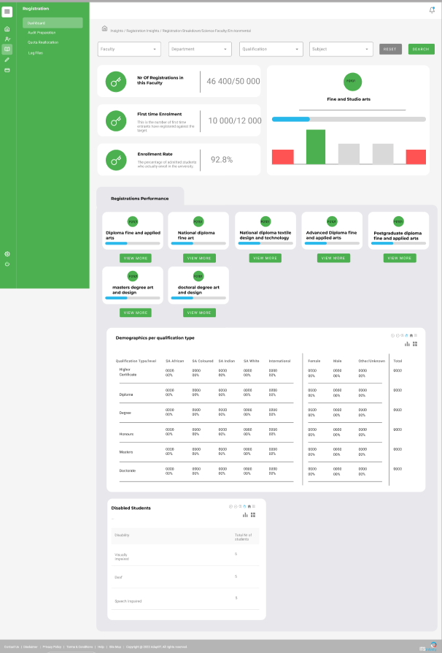
The ITS Experience
Near Real Time
For Faculty and Staff
Notes:
Empower your university with actionable insights! Our insights dashboard for the registration system offers real-time analytics and visualizations, providing administrators with a comprehensive view of enrollment trends, course demand, student demographics, and more. Streamline decision-making, optimize resource allocation, and enhance student experiences with data-driven strategies tailored to your institution's needs. Come to the concept lounge to see more detail.

Slide 9
The five drivers
Notes:
Growth – So, let’s talk about growth. It’s the first tab of our new dashboard and it’s there because we want to see the important stuff first. It’s important because when costs and interest goes up so too must the institution grow, improve and increase its revenue.
Reg performance – Next, we need to talk about the idea of performance. Performance is how we track registrations day by day. How are we doing, where are the gaps? A major painpoint that was pointed out was the lack of visibility on registration performance. How can you know what is going on when it is going on when your system has a 24-42 hour delay or you have to request a report from someone else and be at the mercy of their workload and schedule?
Operations – Operations when focusing on registrations is the logistics and processes that take place during the registration phase. Here you will be able to track metrics and observe patterns. The running of registrations is observed through the operations tab on the insights dashboard.
Finance – Next, we have the finance tab of the registration insights dashboard. Registrations is arguably the most important stage in the institution experience because this is when students are contracted into their courses. With this information you will be able to outline the entire year to come.
Subsidy Performance – The murky topic that is institution subsidy. You know you have a target but how does meeting that target guarantee you the money your institution needs? We unlock the mysteries that is the CESM categories and the 4 major areas of study so that decisions can be made in real time and also with the insights of how this will impact the money given to the institution in a few years' time.

Slide 10
Audit Checklist
Notes:
Ensure compliance and confidence with our audit readiness program tailored for university registration systems. Our solution offers a comprehensive framework to meticulously prepare your institution for audits, seamlessly aligning with regulatory requirements and industry standards. From data integrity checks to process documentation, empower your team to navigate audits effortlessly, safeguarding your institution's reputation and financial integrity.

Slide 11
Quota Reallocation
Notes:
This is a concept we are working on so let me ask who here changes quotas during registration?
You may see a qualification not filling up that fast or another filling up too fast? What do you do? Do you run the risk of underfilling the one qualification or do you transfer some spaces over? Once you transfer those spaces how do you know the impact it will have on your subsidy? Well now we have given you the function, with specific permissions of course, to trade spaces during registration while still maintaining the subsidy requirements and the subsidy outputs.

Slide 12
Growth
Notes:
So, let’s talk about growth. It’s the first tab of our new dashboard and it’s there because we want to see the important stuff first. It’s important because when costs and interest goes up so too must the institution grow, improve and increase its revenue.

Slide 13
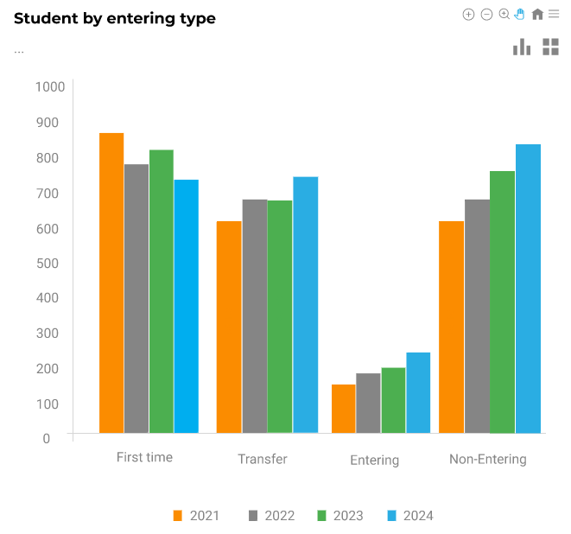
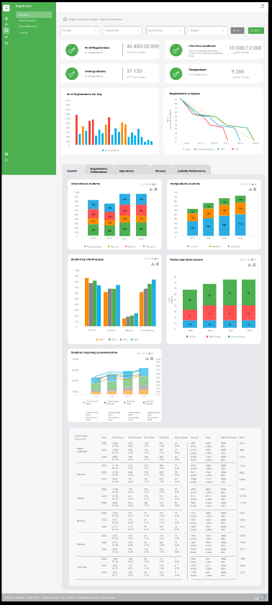
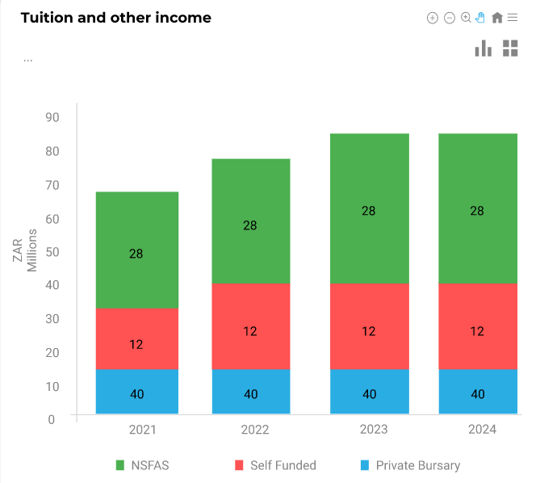
Notes:
These are examples of the graphs that will be displayed. Each focuses on a year-on-year approach. You can see we show the growth on number of international students. The growth by entering type FTEN, we even track financial growth on the tuition income as well as the number of students requiring accommodation. Each of these graphs focusses on showing the change in data from the previous years. This ishow at a glance you will be able to track the major metrics concerning growth t the institution.

Slide 14
Performance
Notes:
Next, we need to talk about the idea of performance. Performance is how we track registrations day by day. How are we doing, where are the gaps? A major painpoint that was pointed out was the lack of visibility on registration performance. How can you know what is going on when it is going on when your system has a 24-42 hour delay or you have to request a report from someone else and be at the mercy of their workload and schedule?

Slide 15
Notes:
Registration Performance can now be tracked using the performance tab of the dashboard. Here you can see how we plan to have a graph per faculty which will drill down to department, qualification, and subject level. In here you will be able to track the capacity of the faculty using the blue bar and the departments within using the bars beneath. You will be able to see which faculty is full and which faculty or department still has space for students with just a glance.

Slide 16
Operations
Notes:
Operations when focusing on registrations is the logistics and processes that take place during the registration phase. Here you will be able to track metrics and observe patterns. The running of registrations is observed through the operations tab on the insights dashboard.

Slide 17
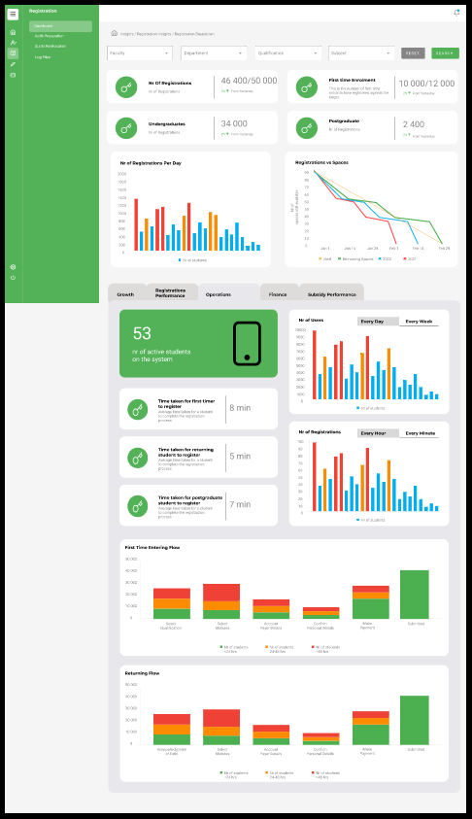
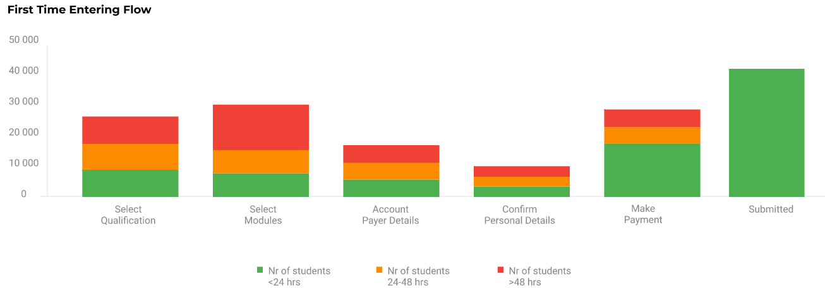
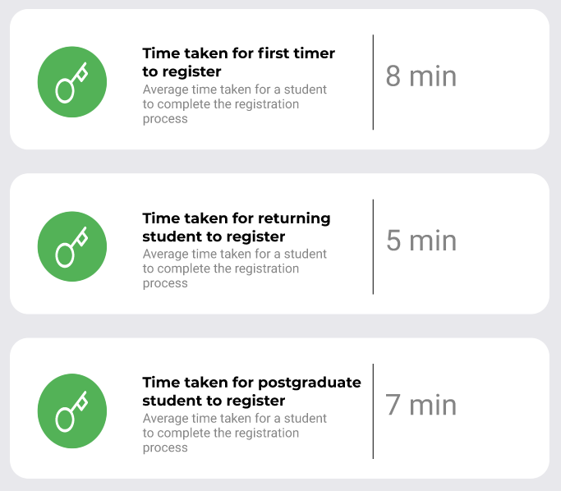
Notes:
We will show you the average time it takes for a given group of students to register and since we acknowledge the differences in student journeys, we have a metric for each of the student types. WE show the number of user every day and every week of registrations. On the smaller image of the full screen, you will note there are multiples of this graph. They each cater to a different timeframe and will be useful for tracking trends during registrations. Perhaps students all register in clumps or there will be quiet period to be aware of. We also have a bar graph to show the process flow of students through the system. This way you will be able to track where students are along the process and access if there are bottlenecks or areas in need of attention.

Slide 18
Finance
Notes:
Next, we have the finance tab of the registration insights dashboard. Registrations is arguably the most important stage in the institution experience because this is when students are contracted into their courses. With this information you will be able to outline the entire year to come.

Slide 19
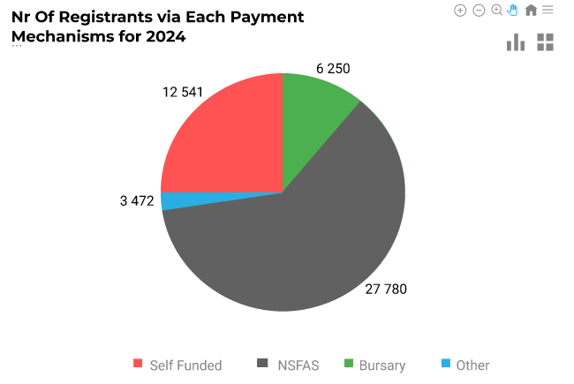
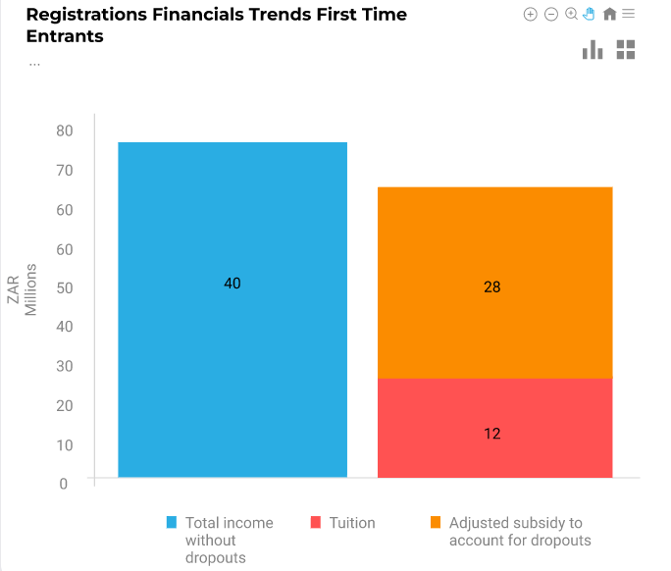

Slide 20
Subsidy Performance

Slide 22
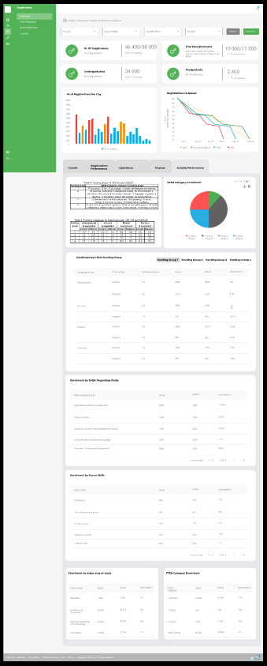
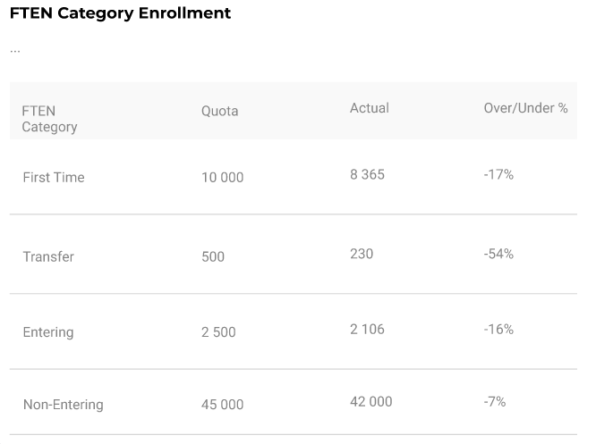
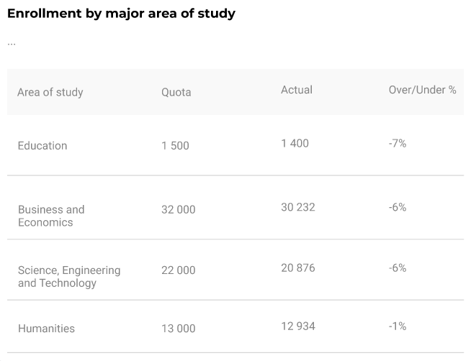

Slide 24
Contributors​
Pravie Govender Pravie.Govender@adaptit.com
Clinton Naidu Clinton.Naidu@adaptit.com
Linda Putu linda.putu@adaptit.com
Thato Mthembu Thato.Mthembu@adaptit.com
David Goodrum
david.goodrum@adaptit.com
Shannon Naidoo Shannon.Naidoo@Adaptit.com
Claire Marais
claire.marais@adaptit.com
Danielle Beetge Danielle.Beetge@adaptit.com
Robyn Harris
robyn.harris@adaptit.com

